Slide 1
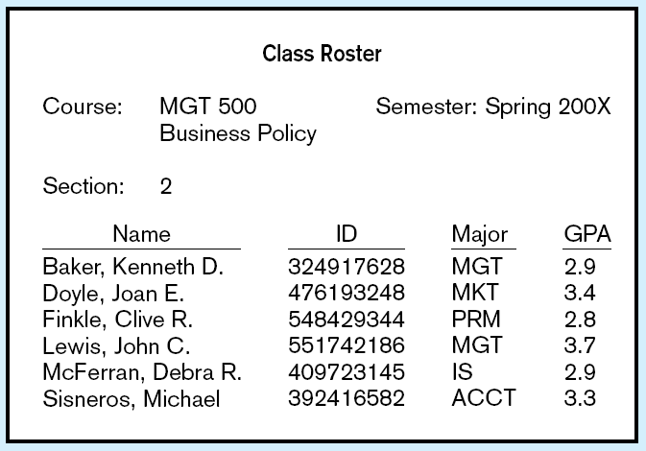
Case Study
A school maintains the following class rosters for each class in a semester

Slide 2
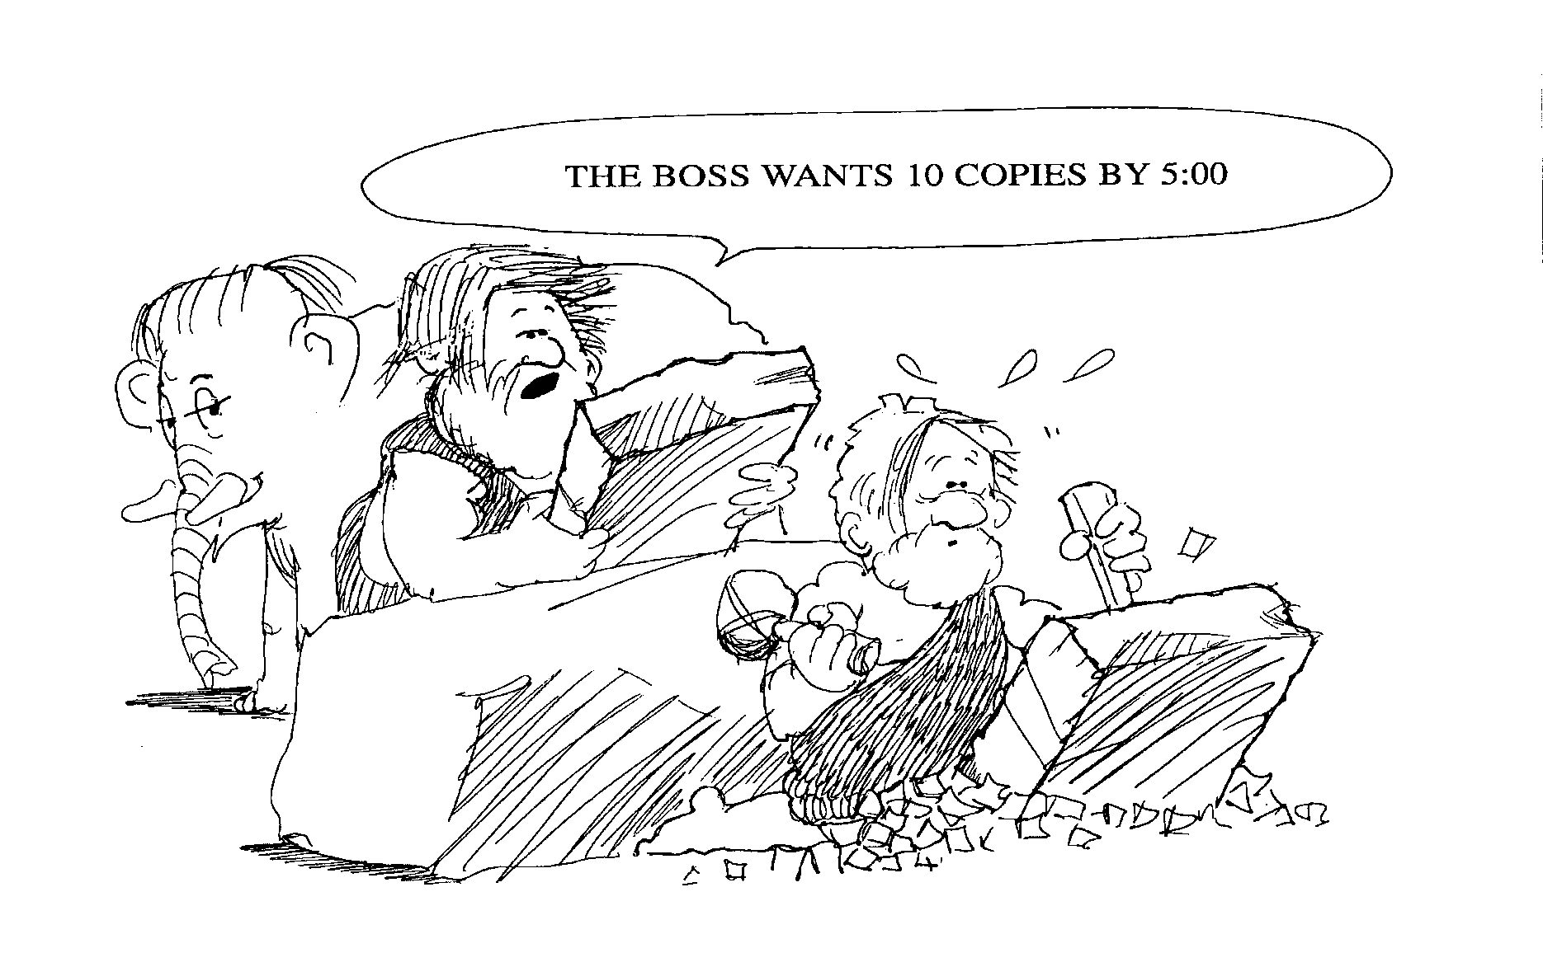

Slide 3
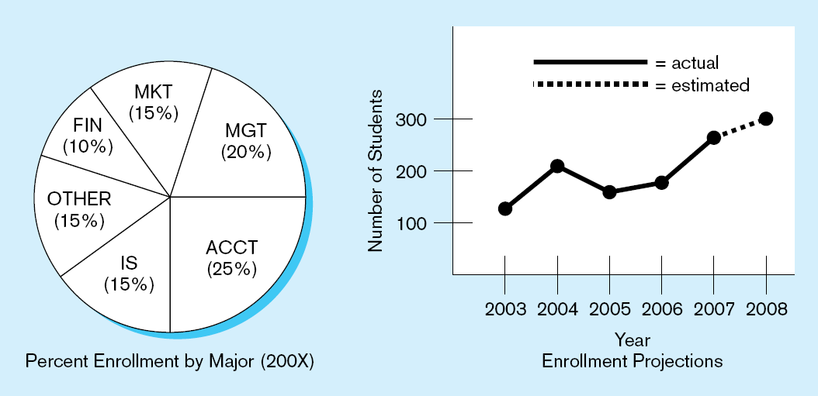
The schools managers need the data summarized as above for decision making

Slide 4
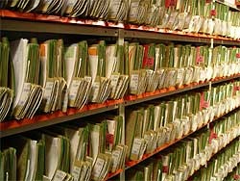
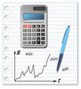

The school used to captures the data in paper files …
…and then with the help of a calculator they prepared the charts and presented them to the management.
The process was manual thus requiring effort, prone to errors, and time consuming!!

Slide 5
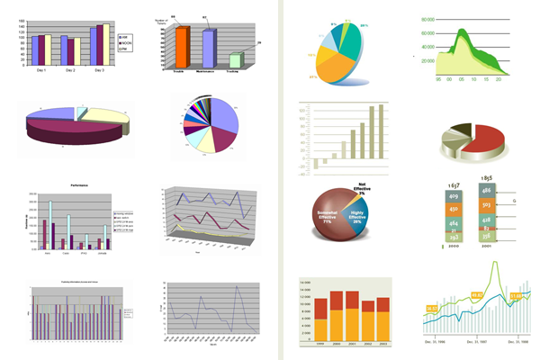
Having heard of the strengths of Ms excel in data analysis they converted the data into Ms Excel worksheets and prepared the charts.

Slide 6

BUT…
The process still required effort, was prone to errors, and time consuming!!
Why??

Slide 7

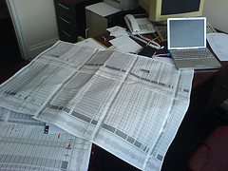

Volume of data…
Data Entry Errors….
Repetition…

Slide 8
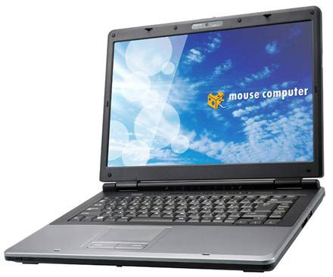


Solution…
When selecting a system factor in…
  1. The users
  Skills available
  3. The technology
  The performance
  2. The organization
  Business problem

Slide 9
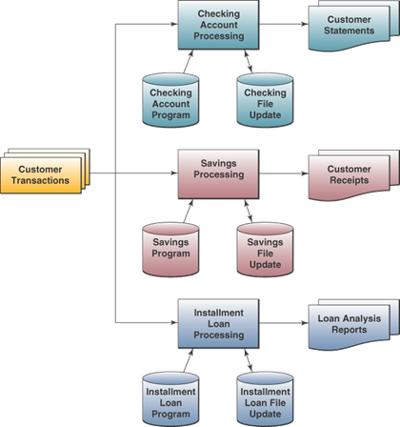
Traditional File Processing
Data stored in independent files
Problems:
  Data redundancy
  Lack of data integration
  Data dependence – files, storage devices, and software are dependent on each other
  Lack of data integrity or standardization
Notes:
Traditional file processing leads to not being able to find data because it’s in multiple files. Or it’s too costly to combine and clean.
Data redundancy – duplicated data in several files
Data is not integrated across files.
Data dependence – software had references to format of data. So maintenance was difficult.
Inconsistency across files.
Problems resolved with Database Management Approach

Slide 10
Limitations of File-Based Approach
Separation and isolation of data - Each program maintains its own set of data. Users of one program may be unaware of potentially useful data held by other programs.
Duplication of data - Same data is held by different programs. Wasted space and potentially different values and/or different formats for the same item.
Data dependence - File structure is defined in the program code.
Incompatible file formats - Programs are written in different languages, and so cannot easily access each other’s files.
Fixed Queries/Proliferation of application programs - Programs are written to satisfy particular functions. Any new requirement needs a new program.

Slide 11
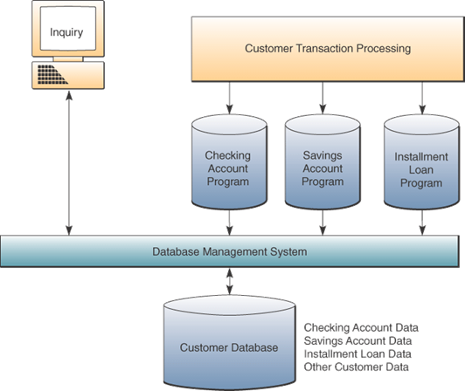
Database Management Approach
Database - Shared collection of logically related data (and a description of this data), designed to meet the information needs of an organization.
Database Management Systems - A software system that enables users to define, create, and maintain the database and that provides controlled access to this database.

Slide 12
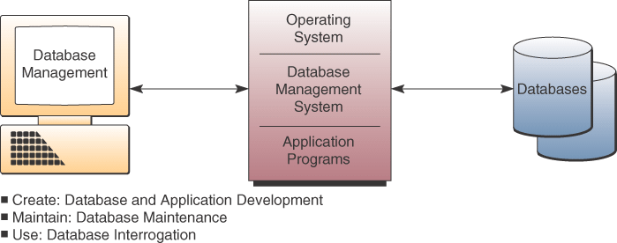
DBMS Major Functions

Slide 13
1. Database Creation
Use DBMS software development tools to develop custom application programs
Data Manipulation Language (DML)

Slide 14
2. Database Maintenance
Updating database to reflect new business transactions such as a new sale
Done by transaction processing systems with support of DBMS

Slide 15
3. Database Use
End users use a DBMS by asking for information via a query or a report generator
Query language – immediate responses to ad hoc data requests
Report generator – quickly specify a report format for information you want printed in a report
Notes:
Database interrogation is major advantage of DBMS approach
SQL is pronounced Sequel

Slide 16
Entities, Attributes and Instances
MEMBER
Member Number | Member Name | Telephone Number
1012 | Isobel Ringer | 293847
1034 | John Silver | 142536
1056 | Fred Flintstone | 817263
1097 | Annette Kirton | 384756

Slide 17
Entities, Attributes and Instances
The Member entity is the whole table
MEMBER
Member Number | Member Name | Telephone Number
1012 | Isobel Ringer | 293847
1034 | John Silver | 142536
1056 | Fred Flintstone | 817263
1097 | Annette Kirton | 384756

Slide 18
Entities, Attributes and Instances
The Member entity is the whole table
Each column stores one attribute, e.g. Member Name
MEMBER
Member Number | Member Name | Telephone Number
1012 | Isobel Ringer | 293847
1034 | John Silver | 142536
1056 | Fred Flintstone | 817263
1097 | Annette Kirton | 384756

Slide 19
Entities, Attributes and Instances
The Member entity is the whole table
Each column stores one attribute, e.g. Member Name
MEMBER
Member Number | Member Name | Telephone Number
1012 | Isobel Ringer | 293847
1034 | John Silver | 142536
1056 | Fred Flintstone | 817263
1097 | Annette Kirton | 384756
Each row stores one instance, e.g. Member 1034

Slide 20
Database Structures
Hierarchical
Network
Relational
Object-oriented
Multidimensional

Slide 21
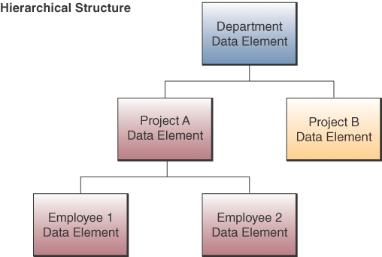
Hierarchical Structure
Early DBMS structure
Records arranged in tree-like structure
Relationships are one-to-many
Notes:
Access data elements by moving progressively downward from the root and along the branches of the tree

Slide 22
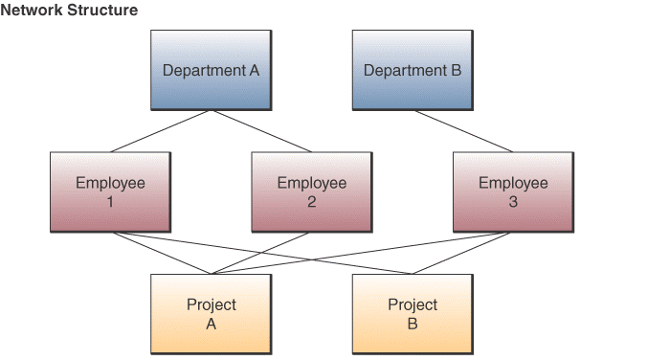
Network Structure
Used in some mainframe DBMS packages
Many-to-many relationships
Notes:
Any data element can be related to any number of other data elements

Slide 23
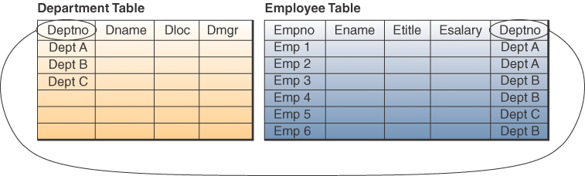
Relational Structure
Most widely used structure
Data elements are viewed as being stored in tables
Row represents record
Column represents field
Can relate data in one file with data in another file if both files share a common data element

Slide 24
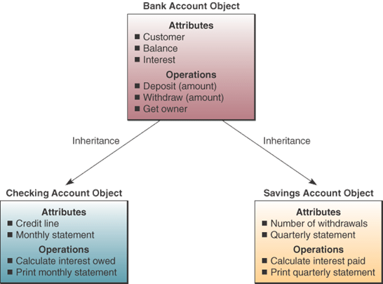
Object-oriented Structure
Object consists of
  Data values describing the attributes of an entity
  Operations that can be performed on the data
Encapsulation:
  Combine data and operations
Inheritance:
  New objects can be created by replicated some or all of the characteristics
  of parent objects

Slide 25
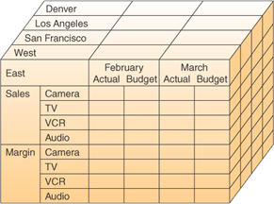
Multidimensional Structure
Variation of relational model
Uses multidimensional structures to organize data
Data elements are viewed as being in cubes
Popular for analytical databases that support Online Analytical Processing (OLAP)
Notes:
OLAP is used for answers to complex business queries, discussed in detail in chapter 9

Slide 26
Evaluation of Database Structures
Hierarchical
  Worked for structured routine transaction processing
  Can’t handle many-to-many relationships
Network
  More flexible than hierarchical
  Unable to handle ad hoc requests
Relational
  Easily respond to ad hoc requests
  Easier to work with and maintain
  Not as efficient or quick as hierarchical or network
Notes:
Gap in performance between relational and hierarchical and network is rapidly narrowing

Slide 27
Advantages of DBMSs
Disadvantages of DBMSs
Control of data redundancy
Data consistency
Sharing of data
Improved security
Economy of scale
Complexity
Size
Cost of DBMS
Additional hardware costs
Cost of conversion
Performance
Higher impact of a failure

Slide 28
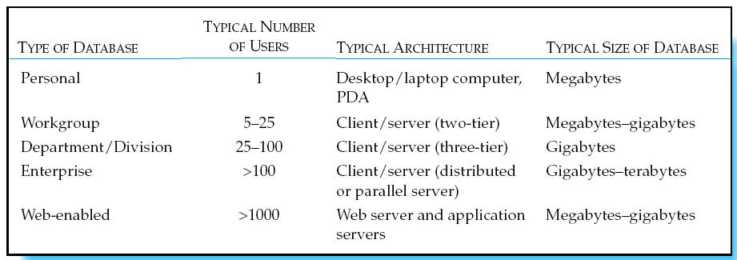
Types of databases
Personal databases
Workgroup databases - Departmental/divisional databases
Enterprise database – ERPs & Data Warehouses
Web-enabled

Slide 29
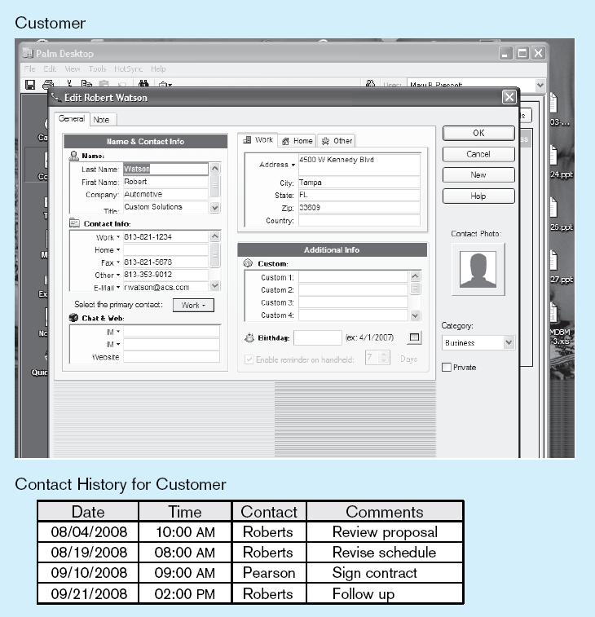
Personal Database

Slide 30
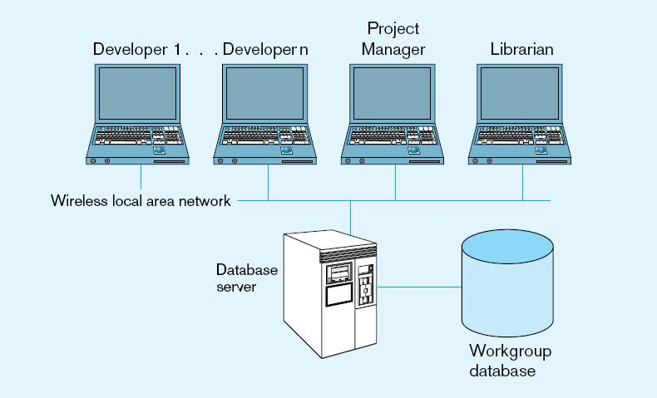
Workgroup database

Slide 31
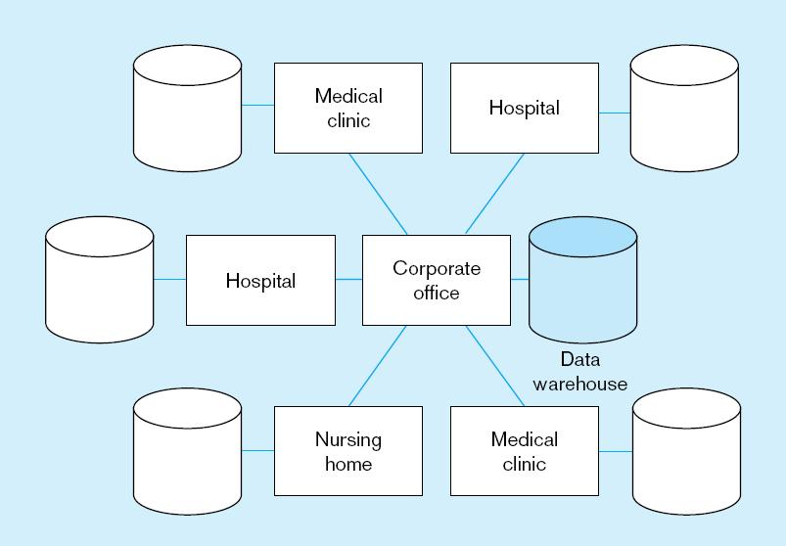
Enterprise Database
Enterprise Resource Planning (ERP)
  Integrate all enterprise functions (manufacturing, finance, sales, marketing, inventory, accounting, human resources)
Data Warehouse
  Integrated decision support system derived from various operational databases

Slide 32
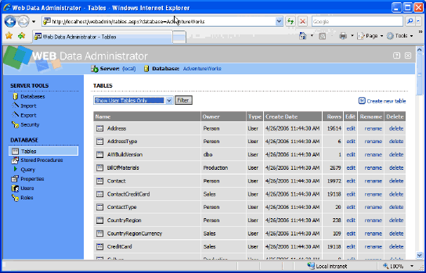
Web-Enabled Databases
Web applications requiring databases
  E-Commerce
  Electronic data interchange (EDI)
  Private intranets
Issues to consider
  Which technologies to use?
  Security/privacy protection
  Managing huge volumes of data from Internet transactions
  Maintaining data quality

